Slide 1
Ggplot2 and interactive graphics with R
Christophe Ladroue
SECTION 03
VIDEO 04
Plotting subsets of data
www.PacktPub.com

Slide 2
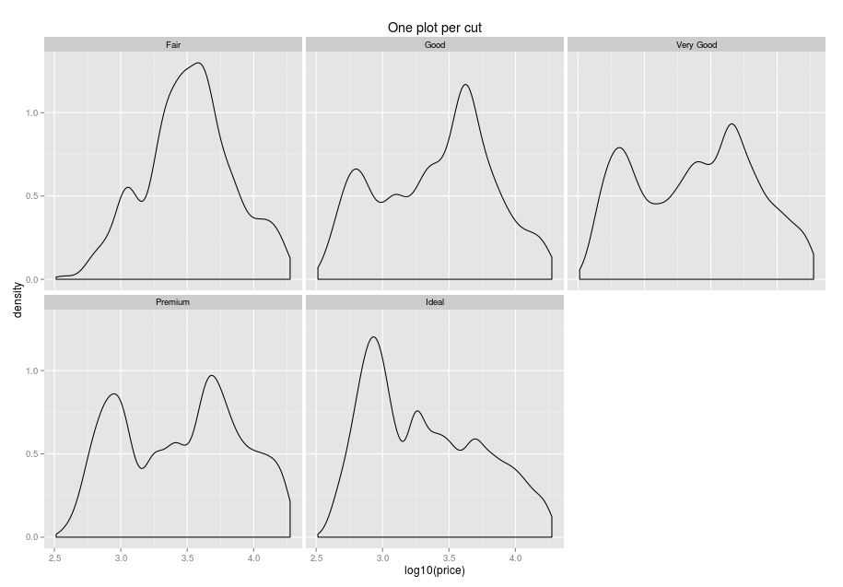
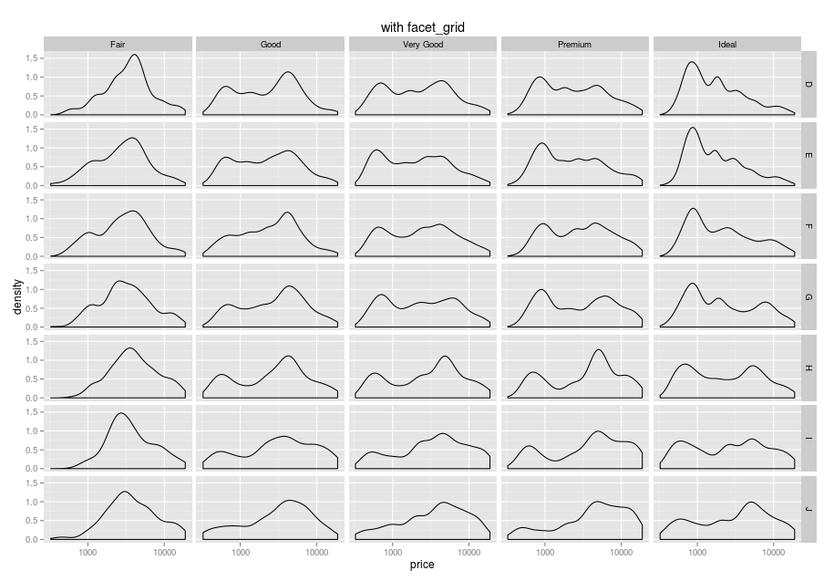
In this video we took a look at
how plotting everything on one single graph can result in a confusing graph.
how we can easily produce more legible graphs by conditioning on one variable.
Next: facetting on multiple variables

